Slide 1
Physics 201
Winter 2013
Newton’s 2nd law

Slide 2
Only the net unbalanced force counts
Winter 2013
Remember me?
Newton recognized that the effect of any force is always captured with the same formula:
This formula is the center of classical mechanics
For a system of objects, each part will obey an independent application of this rule
Show me

Slide 3
Newton’s law requires an inertial frame
Winter 2013
Usually our frame of reference is at rest
But if the frame is accelerating, it is called “non-inertial” and Newton’s second law doesn’t work
We can compensate by introducing an inertial force equal to
This can be used to understand apparent weight, centrifugal force and even general relativity

Slide 4
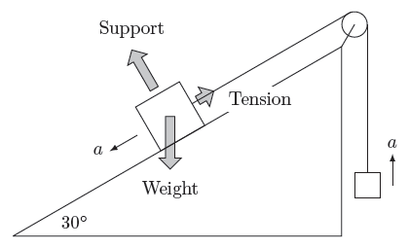
Toughest problem all term
Winter 2013
Show me

Slide 5
How to solve problems involving Newton’s 2nd law
Winter 2013
Classify the problem
If the system is not moving, it is in static equilibrium.
If the motion of the system is constant, it is in kinetic equilibrium.
If the motion is accelerating, it is not in equilibrium.
Circular motion is never in equilibrium.
Identify the forces
Weight? Draw an arrow straight down.
Support? Draw an arrow pointing perpendicular to the surface.
Tension? Draw an arrow along the string.
Kinetic friction? Draw an arrow parallel to the surface opposing the motion.
Static friction? Draw an arrow parallel to the surface to create equilibrium.
Choose reference frame
If the system is not in equilibrium, align coordinates along the acceleration.
If the object is in uniform circular motion the acceleration is toward the center of the circle.
If in equilibrium, align coordinates along most unknown force (usually support or tension).
When in doubt, go ahead and use the standard horizontal/vertical orientation.
Extract the equations
Calculate the net force along every coordinate for every part. Be sure to pay attention to signs.
Do this by calculating the components of all the forces against the coordinate system.
Set this total equal to zero or ma. If the acceleration is down or left, put in a negative sign.
Substitute mg for weight and µN for kinetic friction.
There is no formula for support, tension, or static friction.

